Slide 1
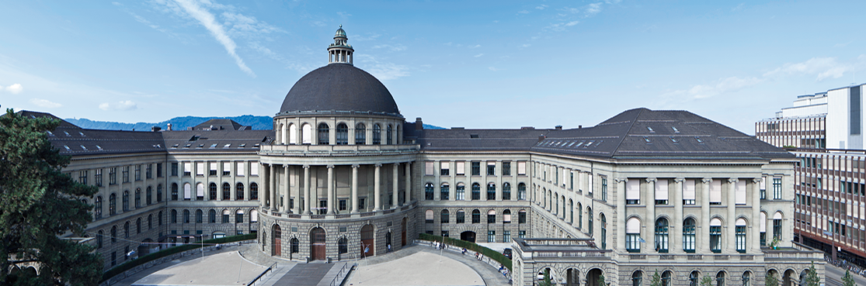
Joint 3D Scene Reconstruction and Class Segmentation
3D Vision – CVG – ETH Zurich
Instructors: Prof. Marc Pollefeys, Dr. Torsten Sattler
Teaching Assistant: Yagiz Aksoy, Johnasses Schönberger, Thomas Schöps, Peidung Liu
Supervisors: Martin Oswald, Pablo Speciale
Students: Adrian Schneuwly, Johannes Oswald, Tobias Grundmann

Slide 2
Overview
Problem & Motivation
Introduction & Related Work
Method
Mathematical Formulation
The Ray Likelihood and Its Approximation
Training the Priors
Experiments & Conclusion

Slide 3
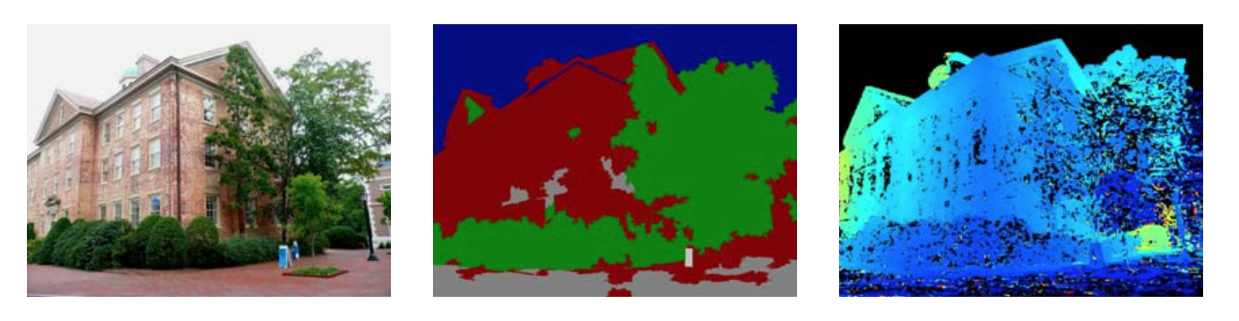
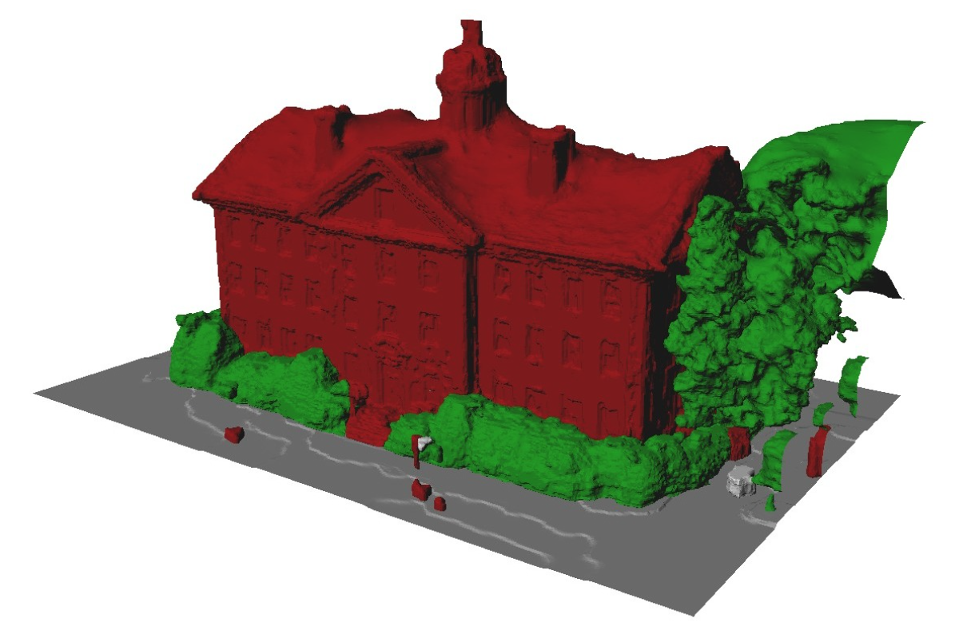
Problem & Motivation
Both ill-posed problems:
Image segmentation
Dense 3D modeling
Solution: Regularizers, but it often fails
Papers approach:
Joint segmentation and dense reconstruction
Why does this makes sense?
Image segmentations
-> cues about surface orientation
Dense 3D reconstruction
-> yields a suitable regularization for segmentation
Input Image
Classification
Depthmap
Result: Accurately labeled 3D reconstruction
Source: Hane_Joint_3D_Scene_2013_CVPR_paper

Slide 4
Introduction & Related Work
TODO: Was am besten hier rein? Oder sogar weg?
Show Video?

Slide 5
Method: Mathematical Formulation
Continuous Formulation
machen oder weglassen?
Ich würde sagen weglassen, siehe Haene 14 im Order References
Er beginnt direkt mit dem Diskreten.

Slide 6
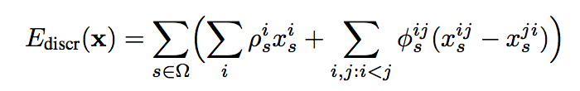
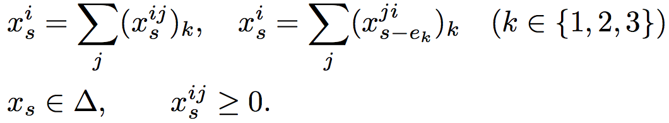

Method: Mathematical Formulation
Discretized Formulation
Goal: Assine label (free or occupied) to each location in finite voxel grid
To do so minimize the convex Energy
subject to the following marginalization, normalization and non-negativity constraints
How can we interprete this?

Slide 7
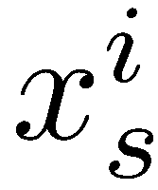
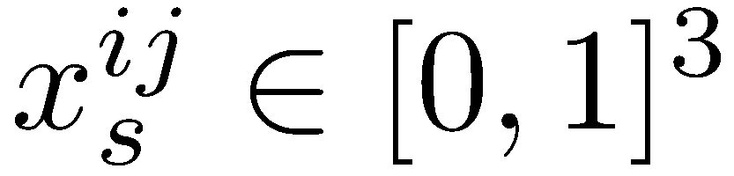
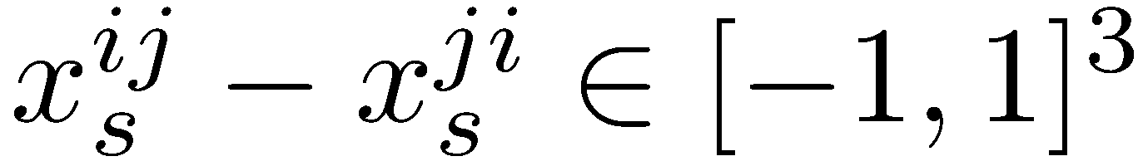
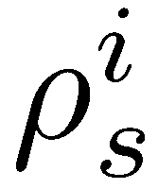

Method: Mathematical Formulation
Discretized Formulation: Interpretation
encodes whether label i is assigned at voxel s
k-th component equals 1 iff transition from label i to j in k-the direction exists
represents local surface/ boundary orientation if it is non-zero
is the unary data term encoding the preference of voxel s for a particular label i
is the (location and) direction-dependent smoothness prior, need to be convex
Indicates (local) compatibility of boundary bewteen label i and j
class-specific geometric priors
Modeled from training data

Slide 8
Method: Mathematical Formulation
Discretized Formulation: Interpretation of the contraints
with
Marginalization: Ensure per node and per edge variables agree in assigned label
Normalization: Ensure that exactly one label is assigned at each position s

Slide 9
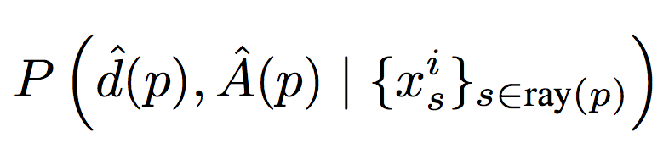
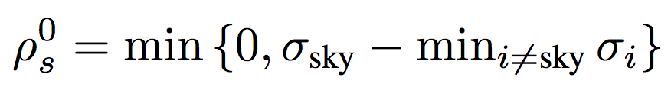
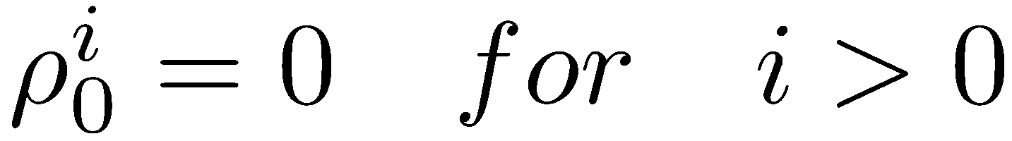
Method: Ray Likelihood and Its Approximation
Goal: Depth maps + appearance-based likelihoods -> unaries ρ
Unaries ρ are calculated along ray from pixel p
Our task: Model the likelihoods
Two cases:
Observed depth
Missing depth
Missing depth -> mostly occur in the sky regions.
We set for all voxels along ray(p)
Indicator function for label i and voxel s
Observed depth
Local image appearance in neighborhoods
Notes:
WAS IST sigma sky, nicht klar an der Stelle.

Slide 10
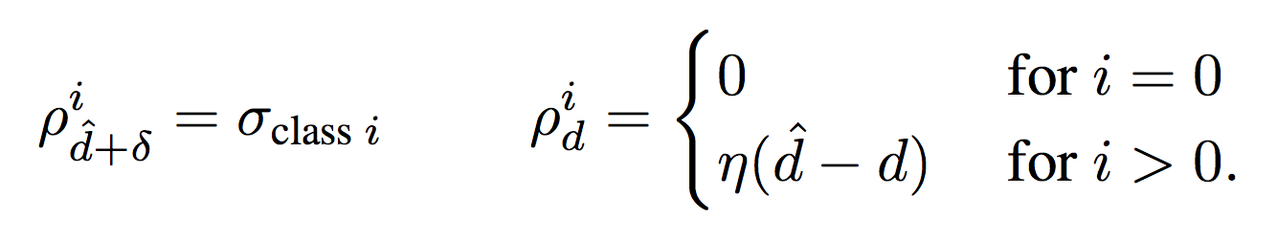
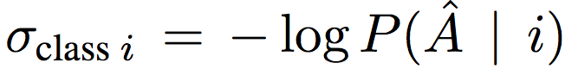
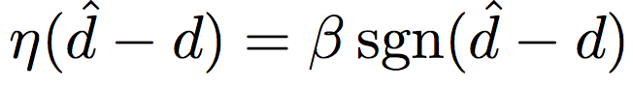
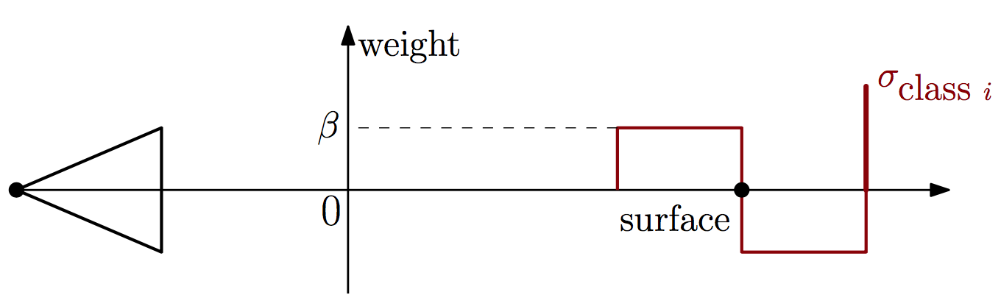
Method: Ray Likelihood and Its Approximation
Case: Observed depth
Assume that likelihoods factorizes into
Assume inlier noise is bounded δ, then
Result:
Confidence of trained appearance- based classifier for object category i
Noise of depth sensing process
Source: Hane_Joint_3D_Scene_2013_CVPR_paper

Slide 11
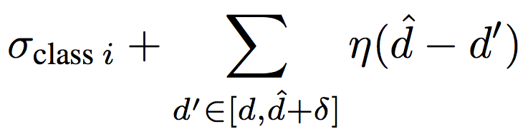

Method: Ray Likelihood and Its Approximation
3 Cases: Contribution of unary terms to the complete energy
Free-space transition to particular object class i at depth d:
Summing yields
All voxels in the range are freespace:
Contribution is just
All voxels in the range are assigned to object label i
Meaning: Transition 1 earlier along the ray
Source: Hane_Joint_3D_Scene_2013_CVPR_paper

Slide 12
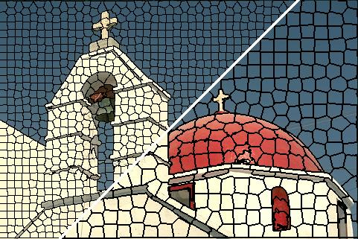
Method: Training the Priors
Appearance Likelihoods
Goal: classification scores for the
labels in the input images
We train a boosted decision tree classifier
Training images are segmented into super-pixels (mean shift)
225 dimensional feature vectors based on color, intensity, geometry, texture, location
Classifier is trained over 5 classes: sky, building, ground, vegetation, clutter
Result: Scores represent the log-likelihoods of each class for each region of the image
Super-pixels
Source: Achanta et al: SLIC Superpixels Compared to State-of-the-art Superpixel Methods
Notes:
What is this mean shift segmentation algorithm? http://stackoverflow.com/questions/4831813/image-segmentation-using-mean-shift-explained

Slide 13
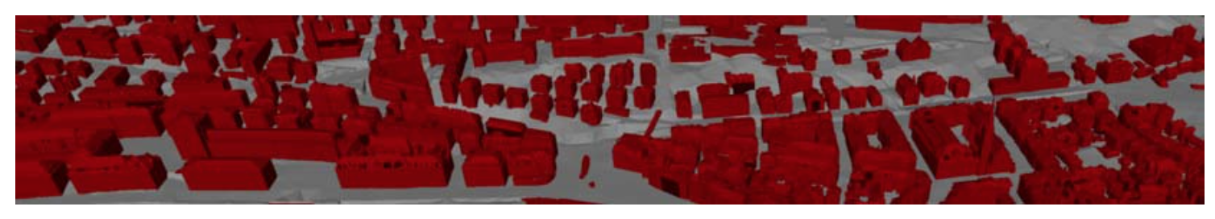
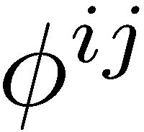
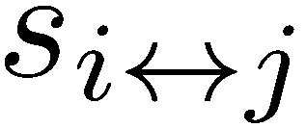
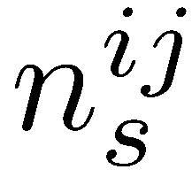
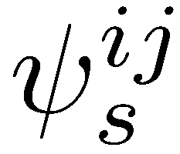
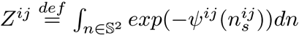
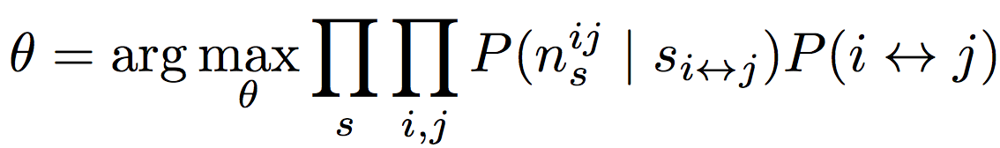
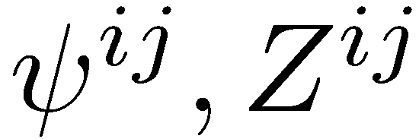
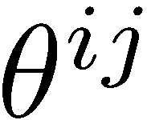
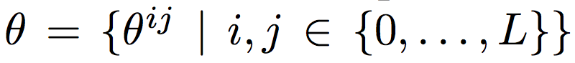
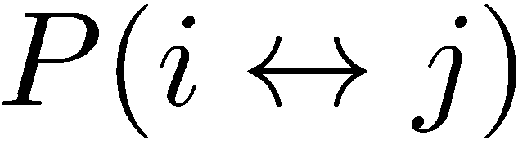
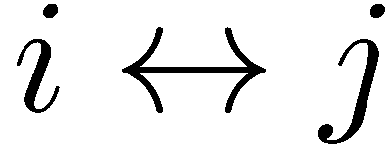

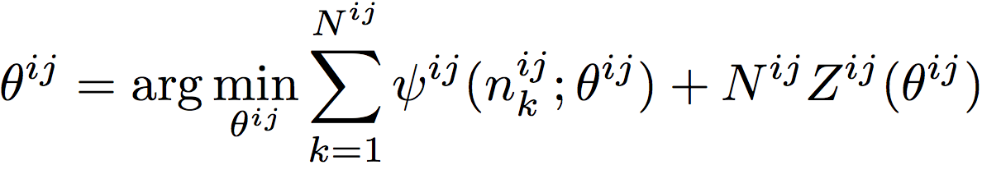

Method: Training the Priors
Class - Specific Geometric Priors
Goal: Model
denotes a transition event between label i and j at voxel s
be the unit-length boundary normal at this voxel s
Instead of moedling direclty, we use
Modeled as a Gibbs probability measure
for a pos. 1-homog. Function and the respective partition function
Consequently
To fit parameters to training data, use ML-estimation
over all training samples s , functions of which are gathers in
Estimate probability of upfront by counting frequencies
from training data -> decouples ML-estimation into
What is this function ?
section of cadastral city model
Notes:
We leave the remarks and th monte carlo thing for the interesed?

Slide 14
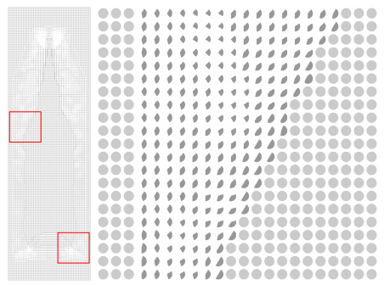
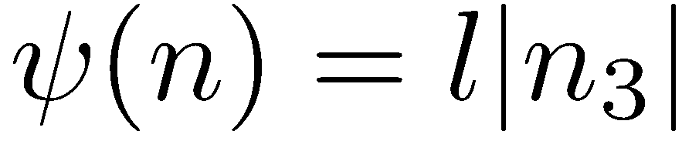
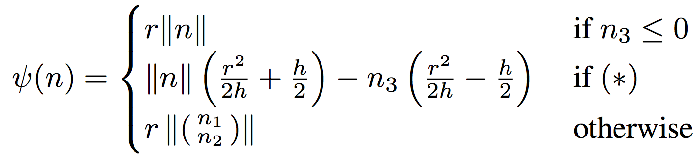
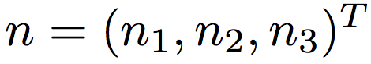
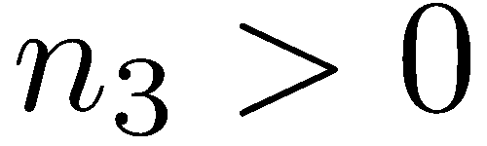
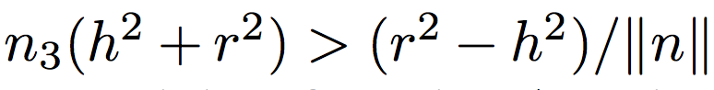
Method: Training the Priors
Class - Specific Geometric Priors
What is this function ?
Restrict to be convex and positively 1-homogenous
We choose to parametrize the convex conjugate of
the indicator function for a convex Wulff shape -> easier to parametrize
Which Wulff shape is picked for -> part of the ML estimation
Wulff shapes designed to model two frequent surface priors
prior favors surface normals aligned with specific direction ( ground normals <-> vertical)
Prior favors surface normals orthogonal to given direction ( facade normals <-> vertical)
Wullf shape: Line Segment in z-direction at origin with length 2l ->
Wullf shape: Half-sphere with radius r centered at origin in opposition to spherical cap with height h
with where (*) is
and
Wulff-shapes at neck of bottle

Slide 15
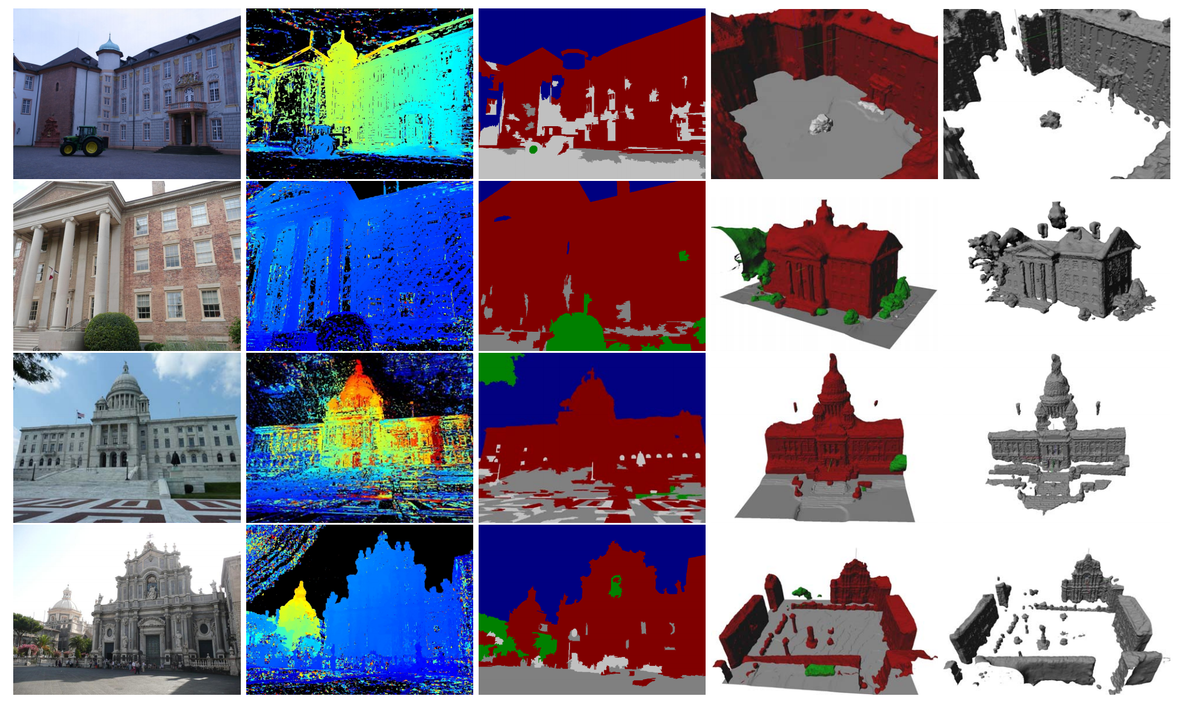
Experiments & Conclusion
The approach leads to more accurate geometry and image segmentation is improved (Col. 4)
Image & Depth map
Raw Image Labeling confuses:
Ground, building and clutter
TV-Flux (standard): Misses ground fully,
Particially facadas and roof structure
Source: Hane_Joint_3D_Scene_2013_CVPR_paper
Notes:
Foto ist auf der rechten Seite, damit wir zeigen können wo das Problem bei Tensorflow wo was wir jetzt durch Keras behoben haben.

Slide 16
Thank you!

